Slide 1
Online Roller Production & Selling Managenment
UNIV SEAT NO. | NAME
1607 | PATIL PAVAN ANANDA
1623 | VAGHELA SAHIL SANDIPBHAI

Slide 2
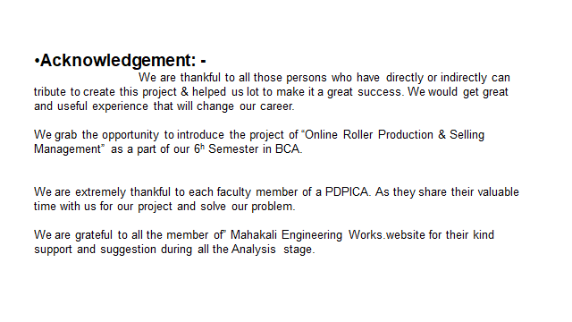

Slide 3
1.Project Profile: -
Project Definition: Online Roller Production & Selling Management.
Project Description:
In online roller production & selling we manage Manufacturing of ebonite & rubber roller, hard Crome roller, Aluminum roller and selling online. Customer can easily order the roll by his requirement.
In our web application customers can easily own profile and admin manage product, suppliers and raw material will manage by admin.
Admin manage actual work and generate bill as per order.
Company Description:
→Our Company Name is Mahakali Engineering Works.
→It is Manufacturing Ebonite & Rubber Roller, Hard Crome Roller, Aluminum Roller. That all type of rollers uses in industries for Plastic Machine, aglo machine for plastic. Customer order the Roller as Per his requirement.
→Address: 186, Vijay industrial Estate B/H Bhikshukgruh Central Workshop Road, Odhav, Ahmedabad, Gujrat.
→ Owner Detail & Contact No.: - Lalit Santosh Patil.
Mobile No.: - 7433091598

Slide 4


Slide 5
ADMIN PANEL

Slide 6
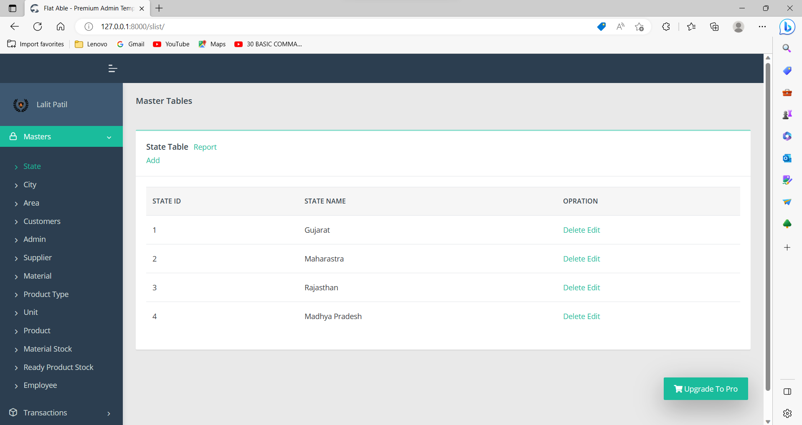
State Table:-

Slide 7
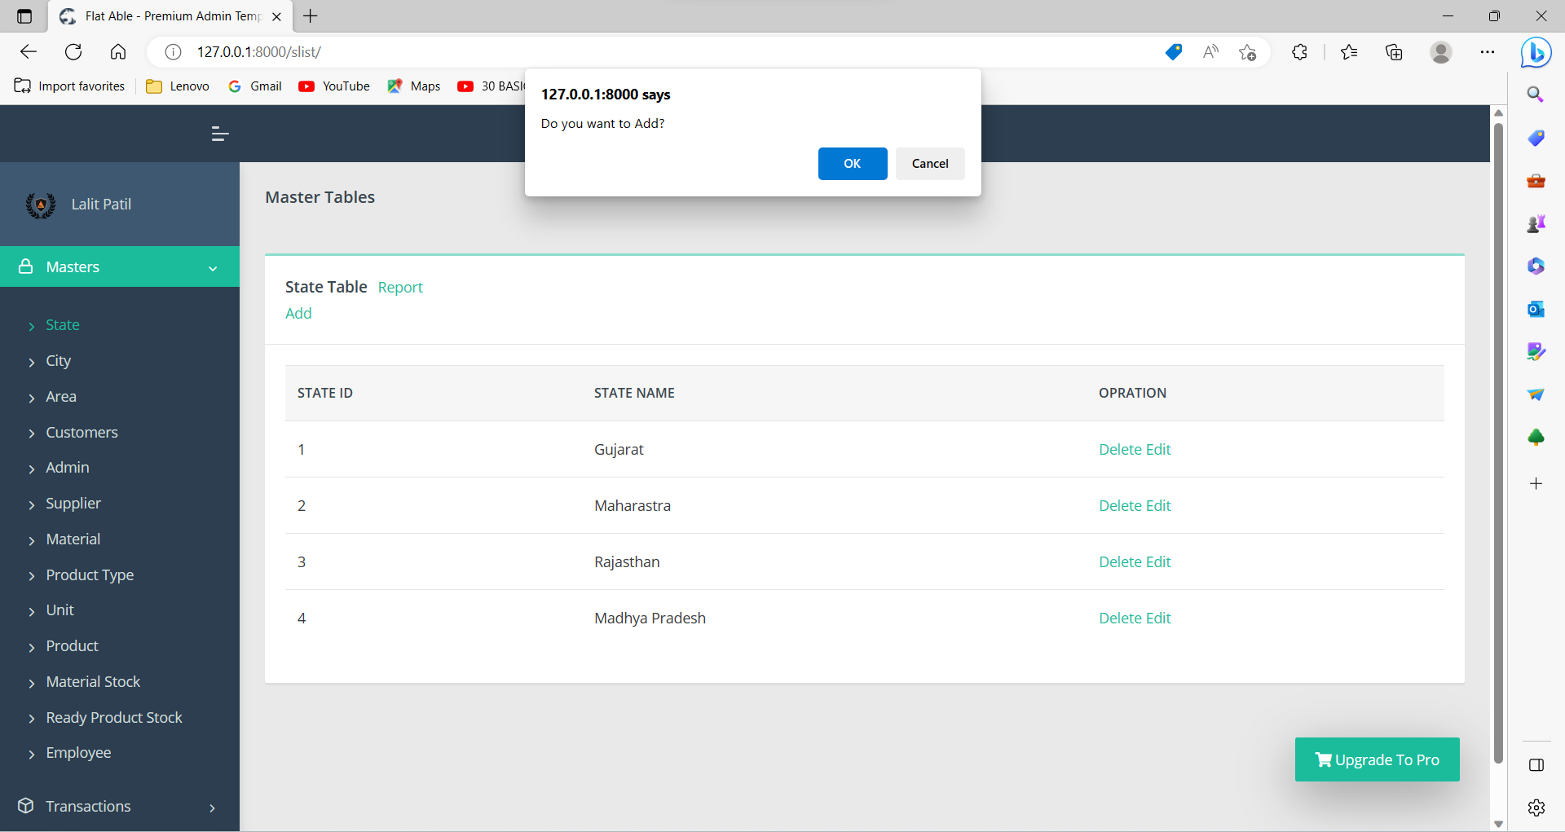

Slide 8
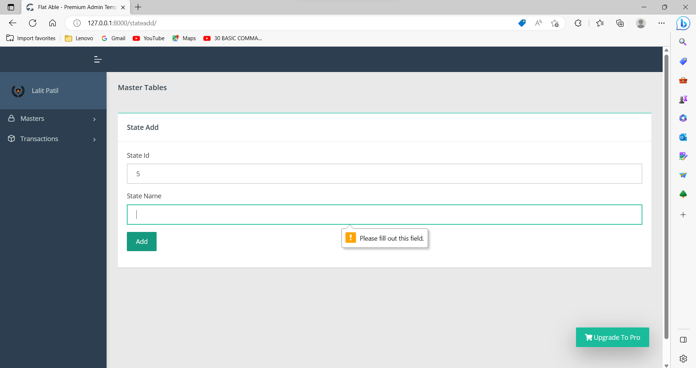

Slide 9
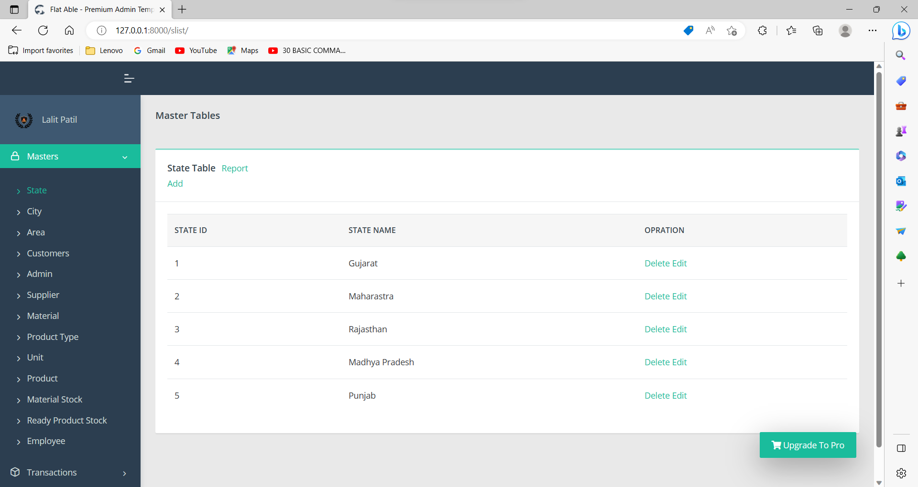

Slide 10
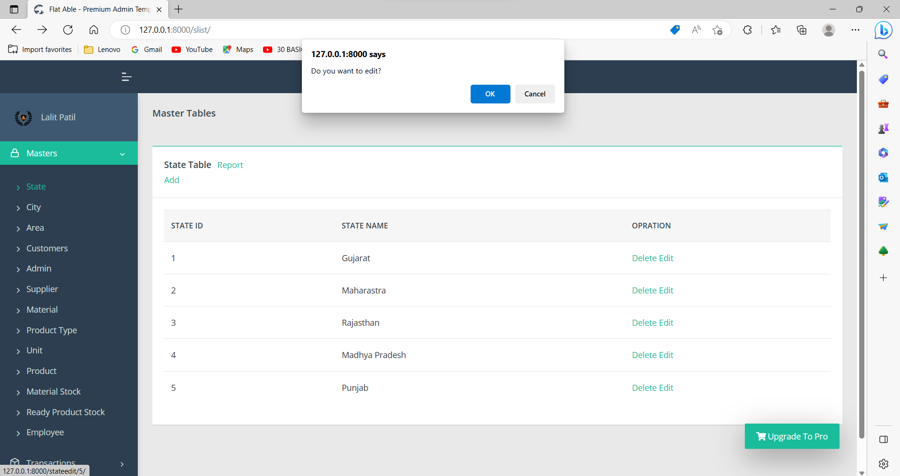

Slide 11
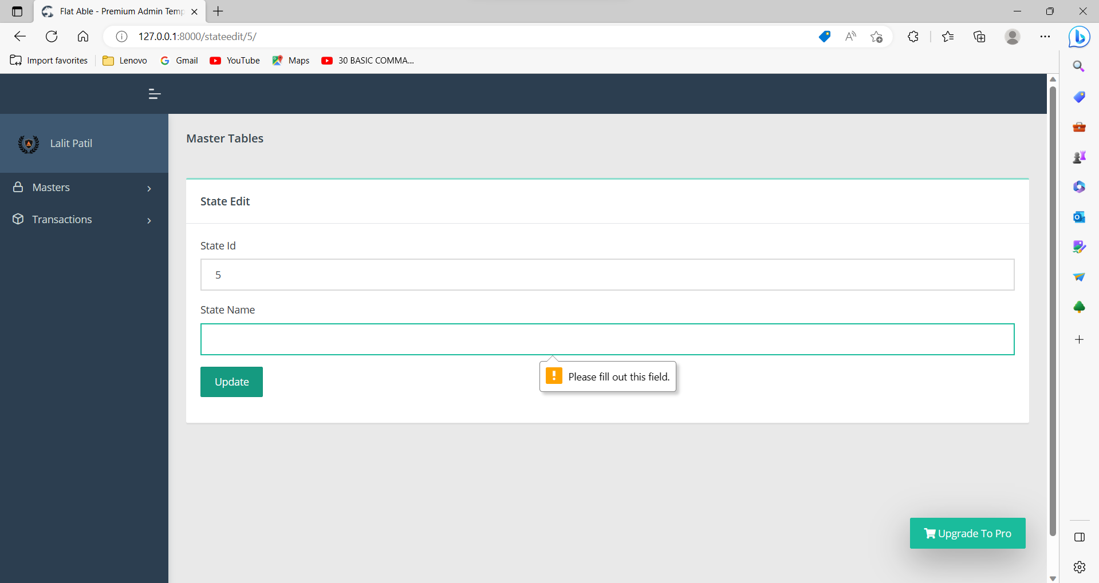

Slide 12
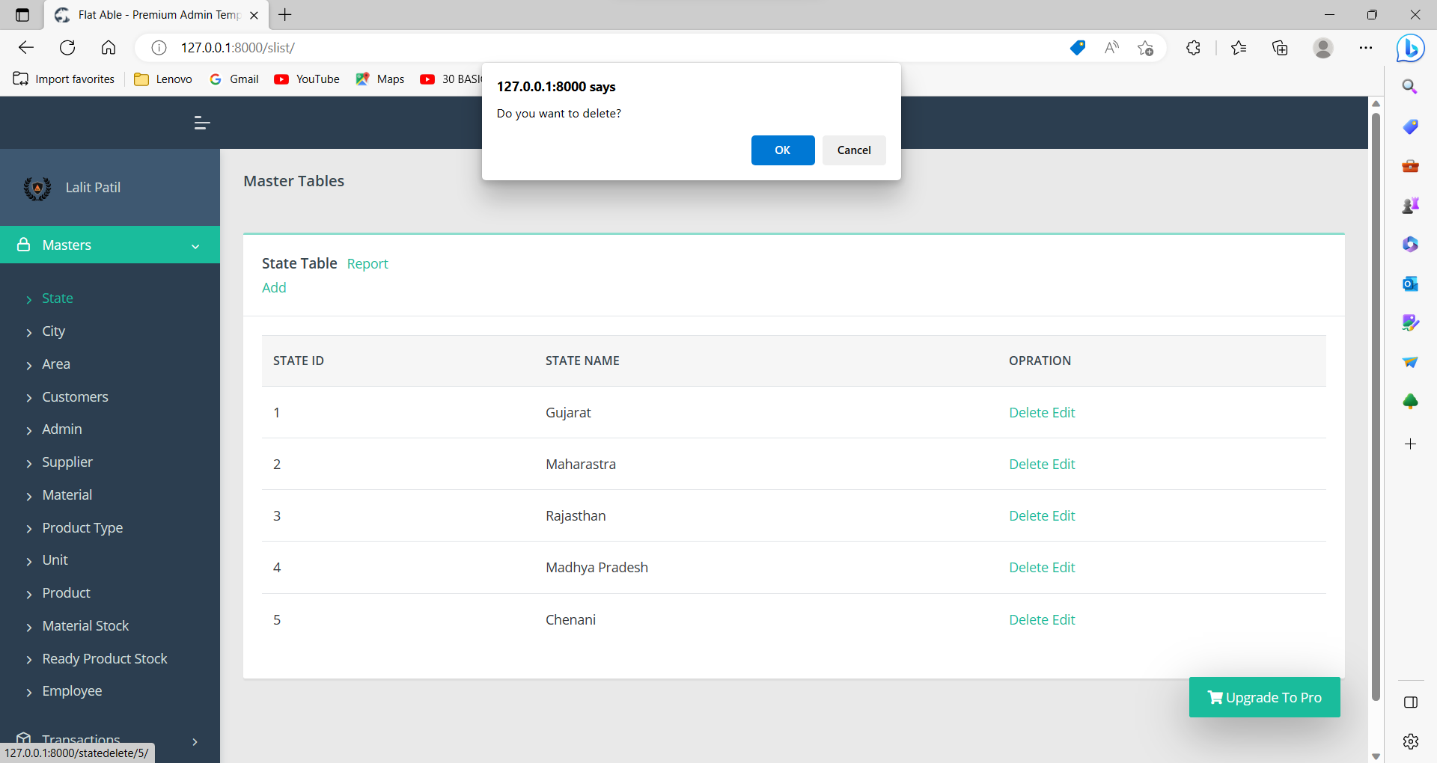

Slide 13


Slide 14
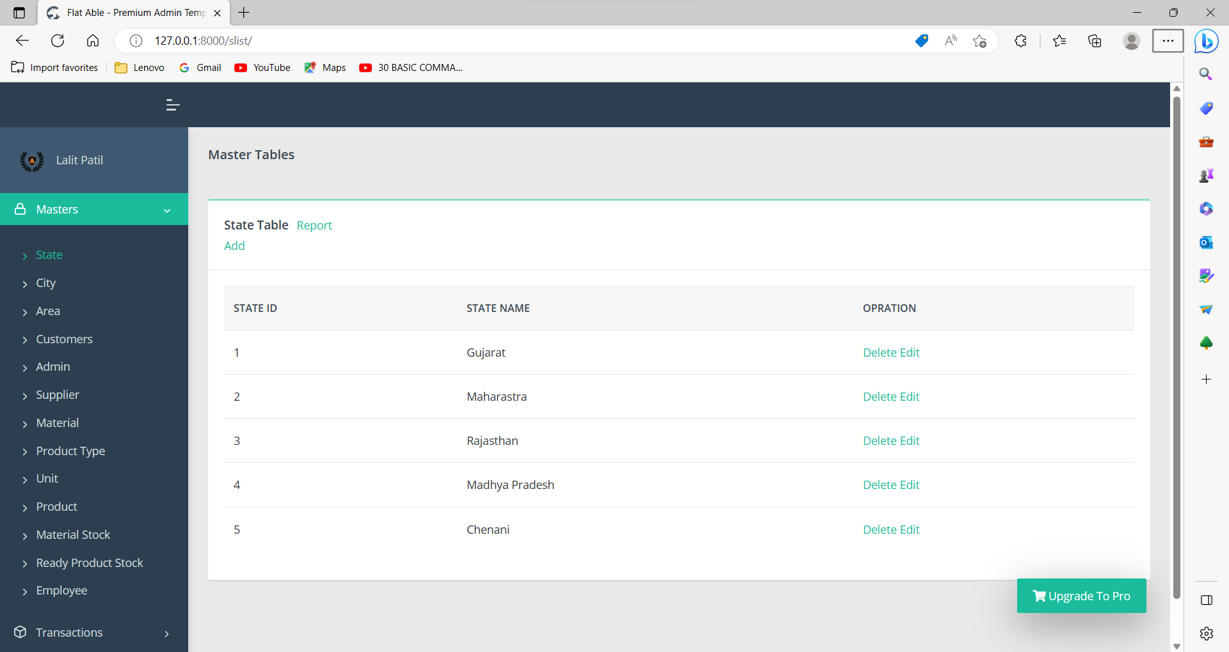

Slide 15
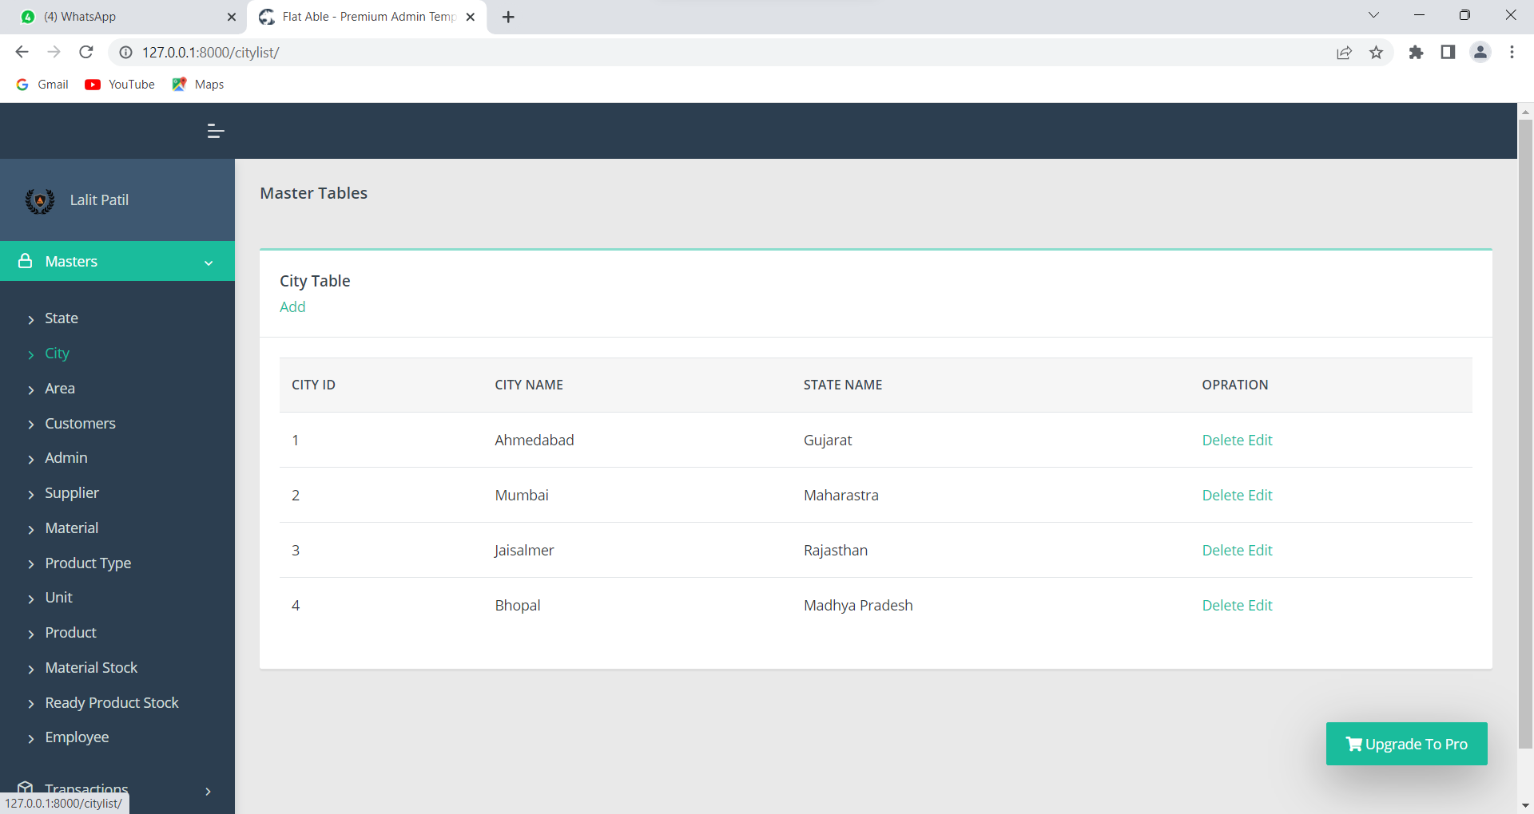
City table:-

Slide 16
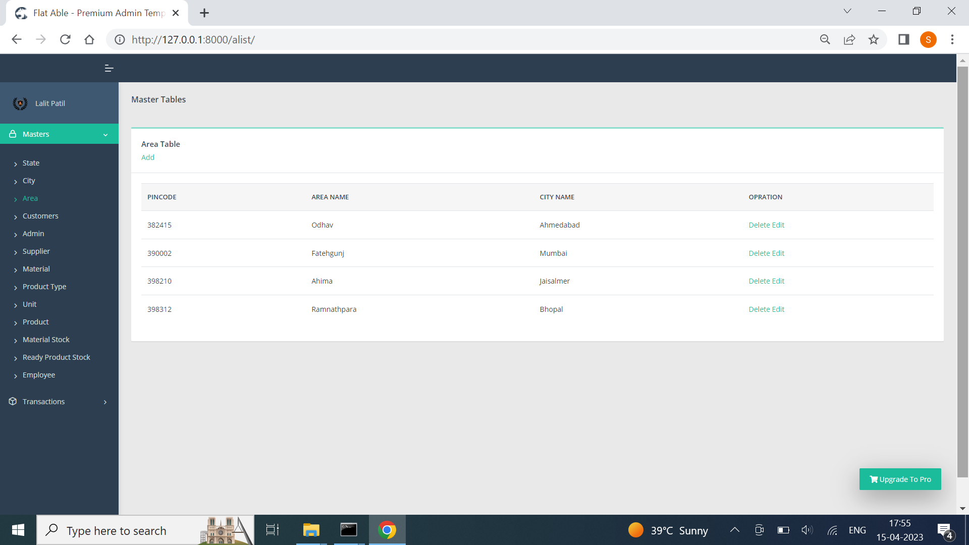
Area table:-

Slide 17
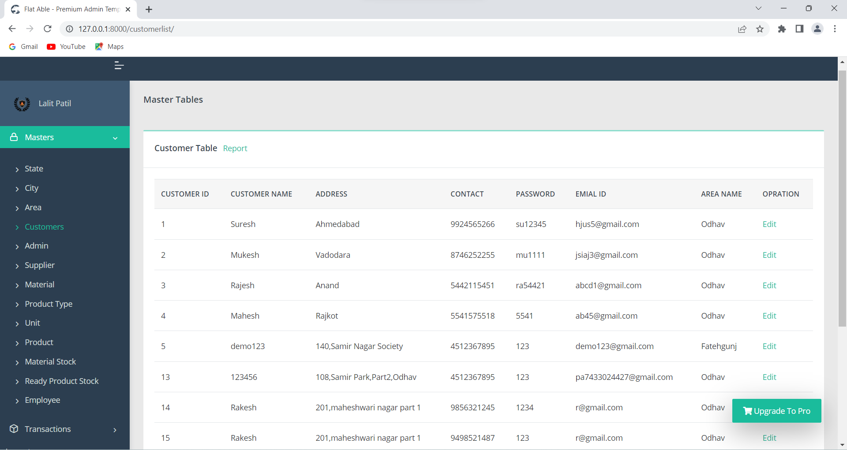
Customer table:-

Slide 18
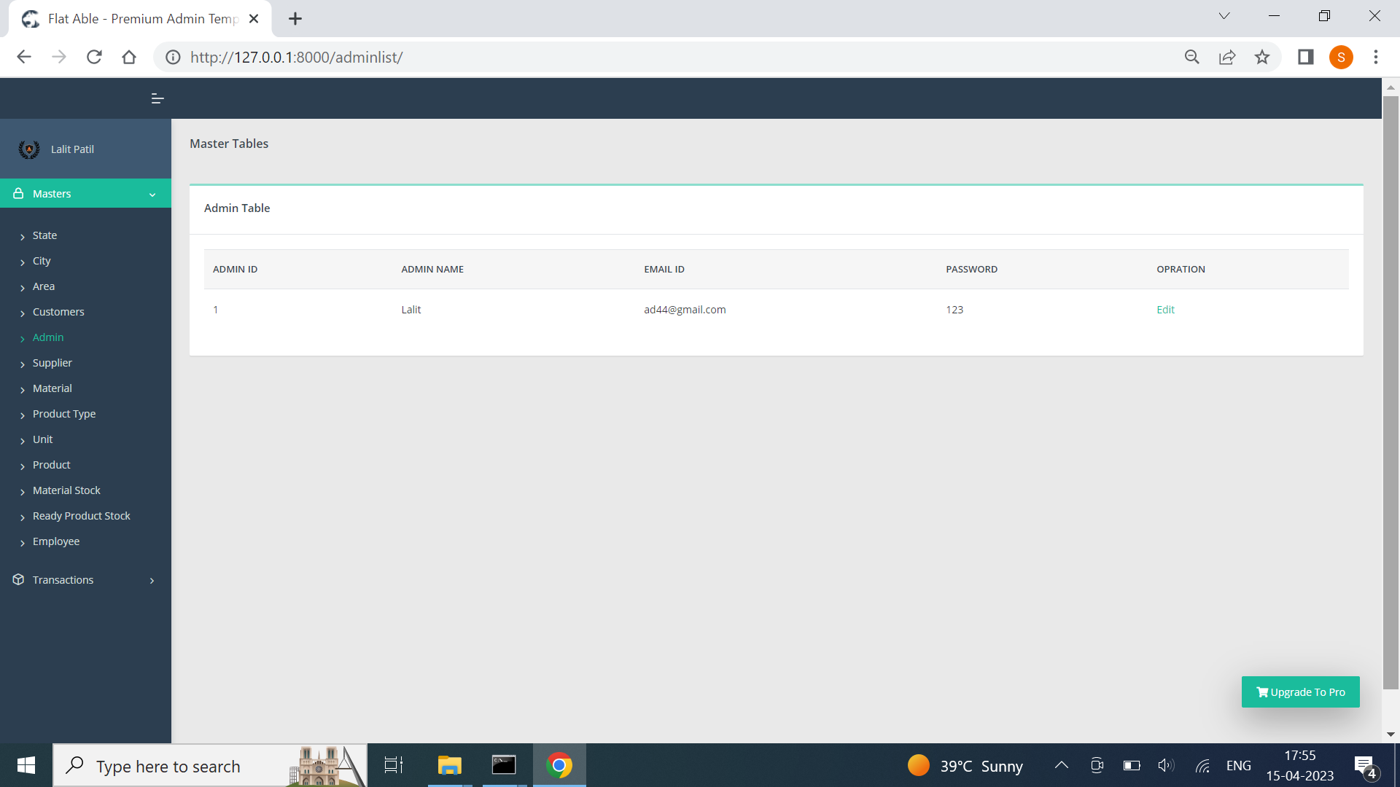
Admin table:-

Slide 19
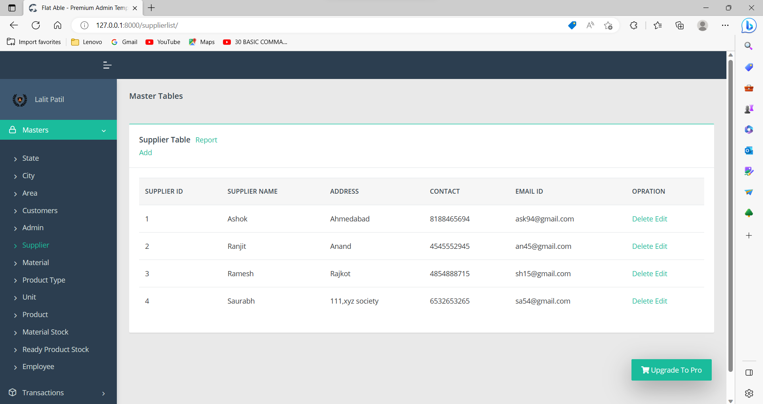
Supplier table:-

Slide 20

Material table:-

Slide 21

Product type table:-

Slide 22

Unit table:-

Slide 23
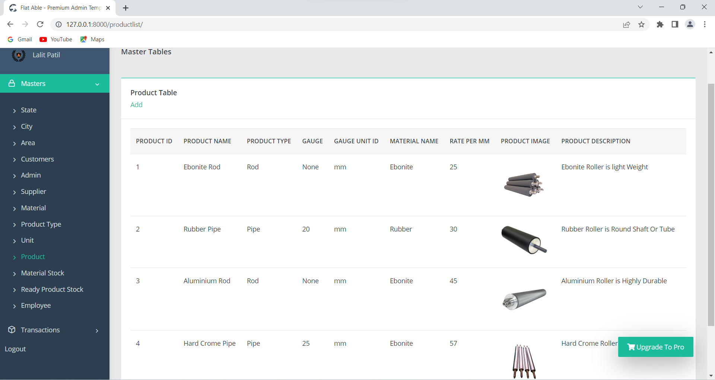
Product table:-

Slide 24
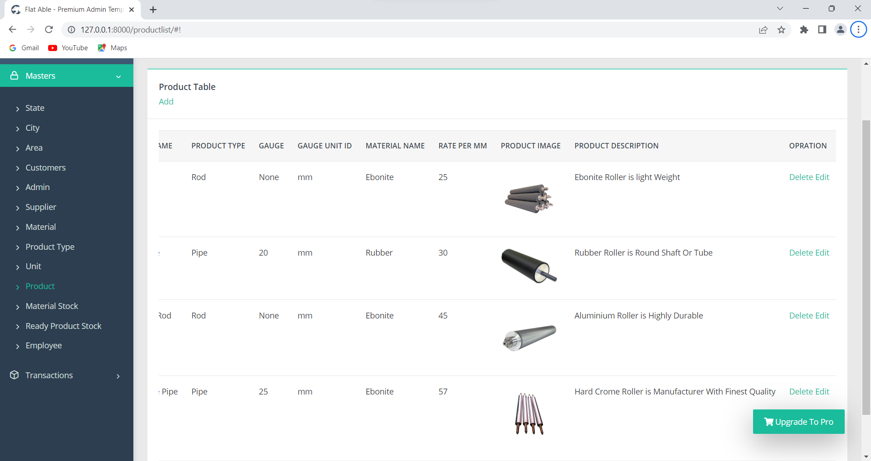
Product table:-

Slide 25
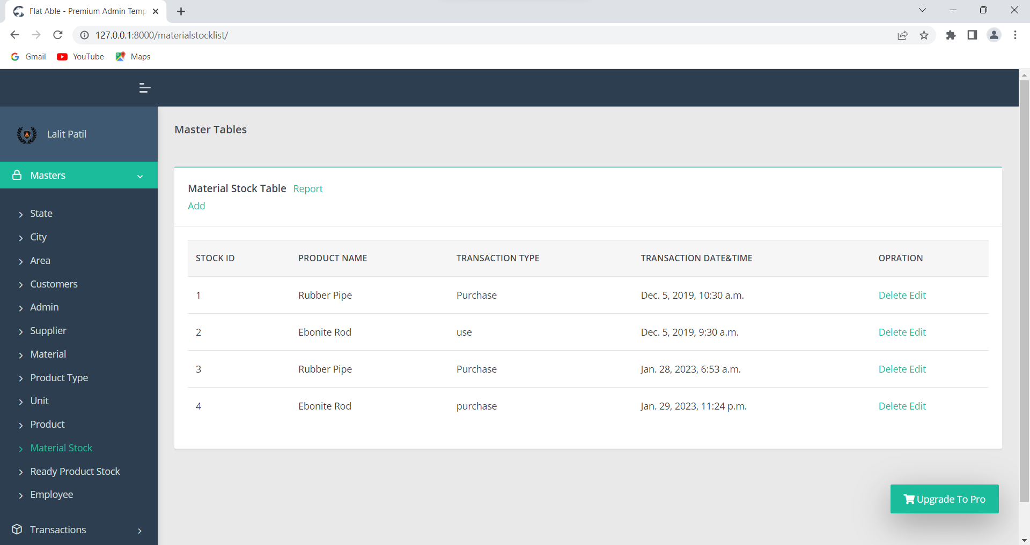
Material stock table:-

Slide 26
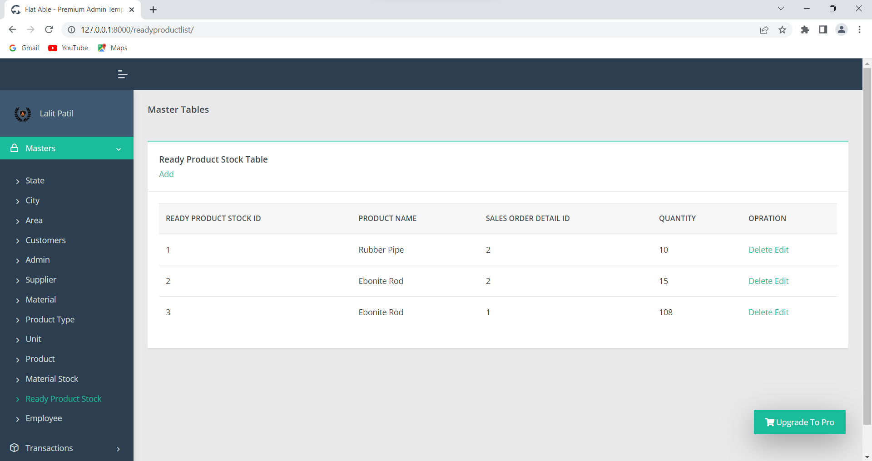
Ready product stock table:-

Slide 27
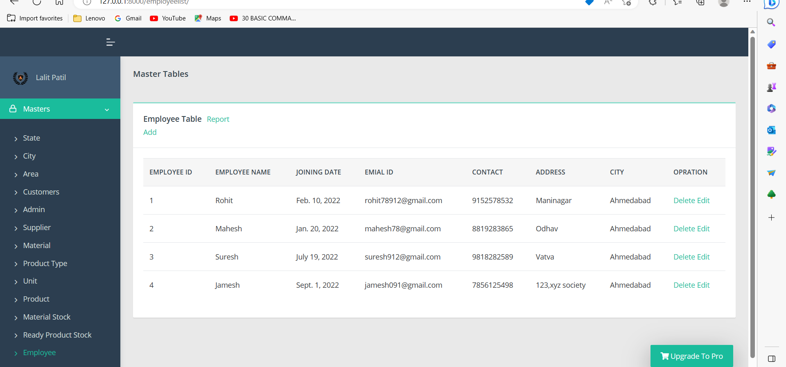
Employee table:-

Slide 28
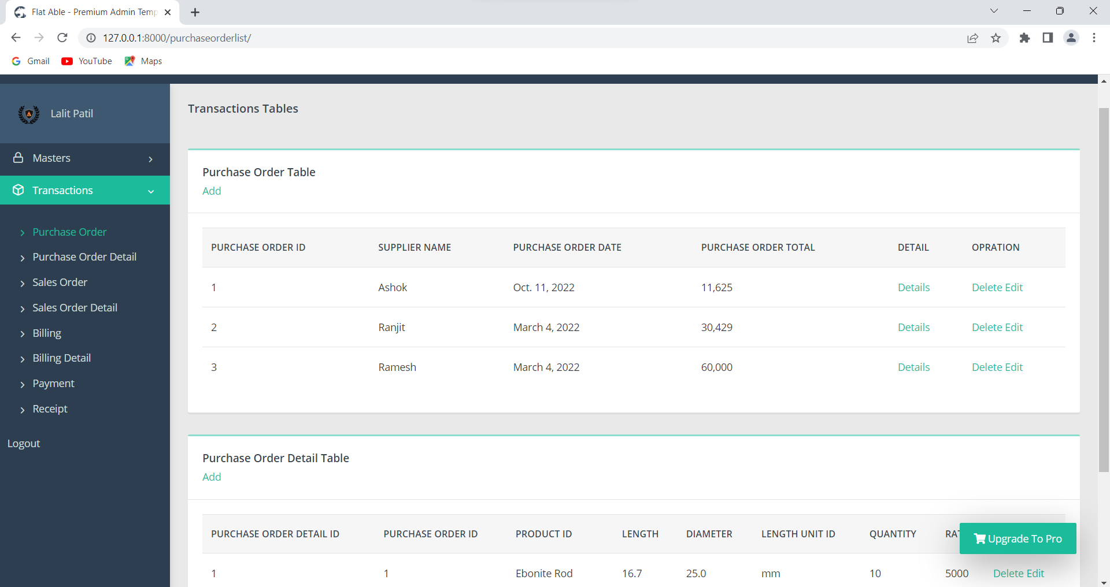
Purchase order table:-

Slide 29
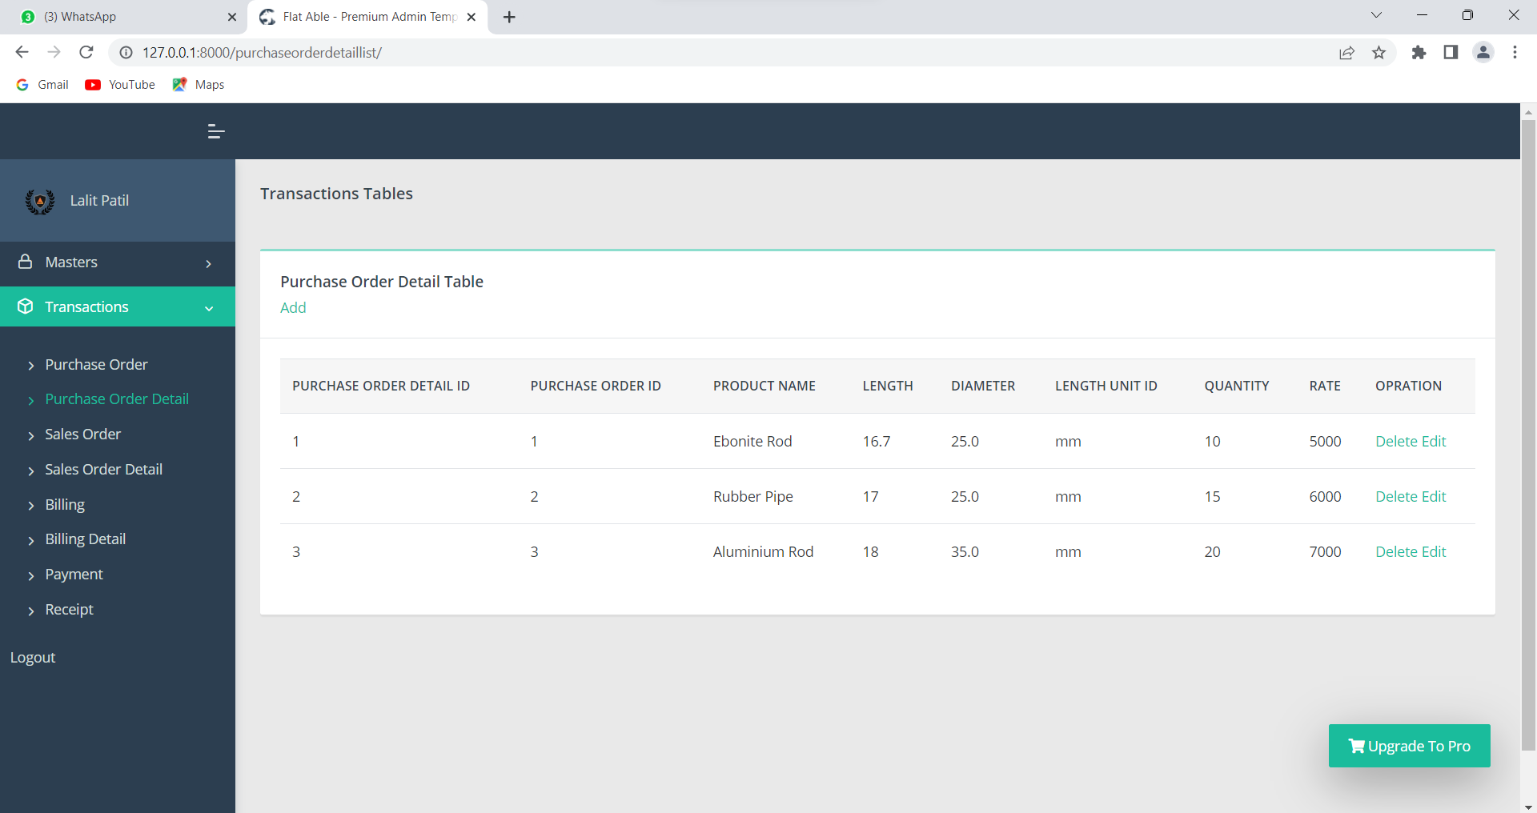
Purchase order Detail table:-

Slide 30
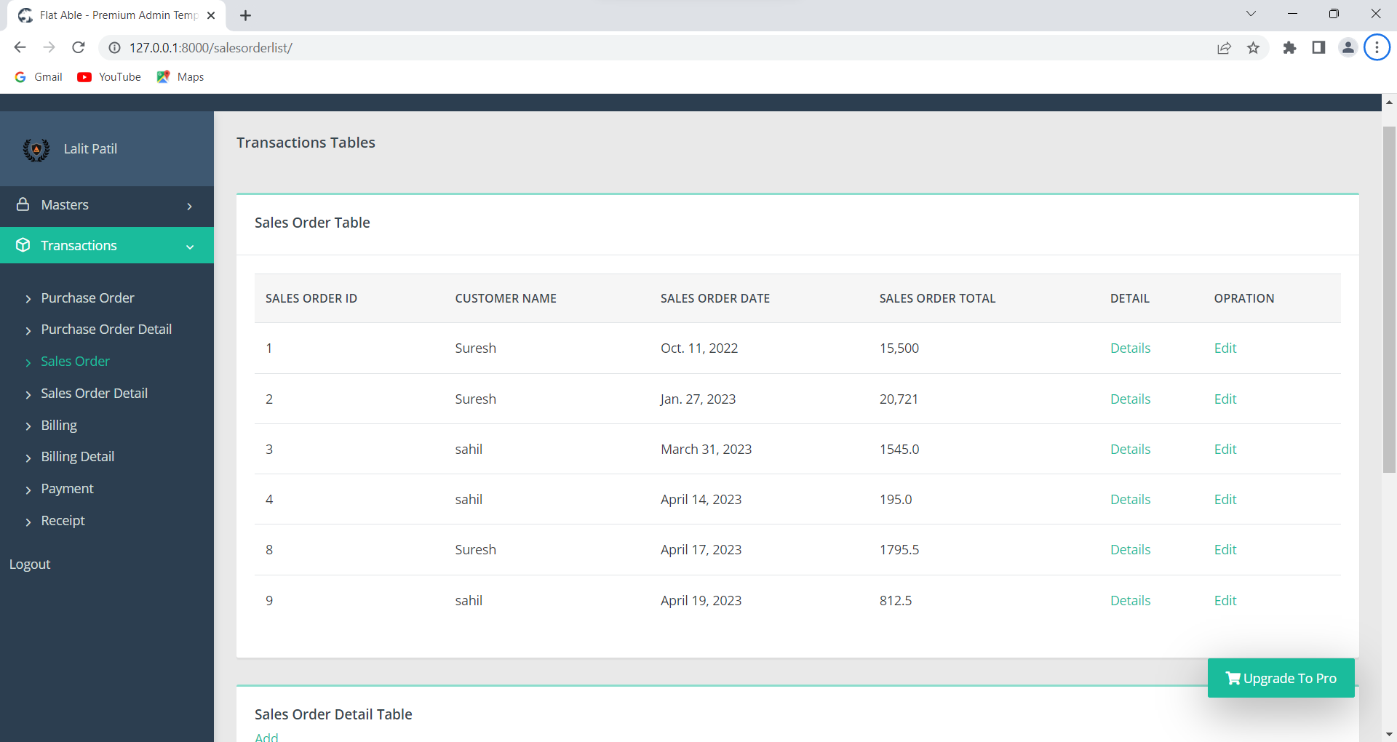
Sales order table:-

Slide 31
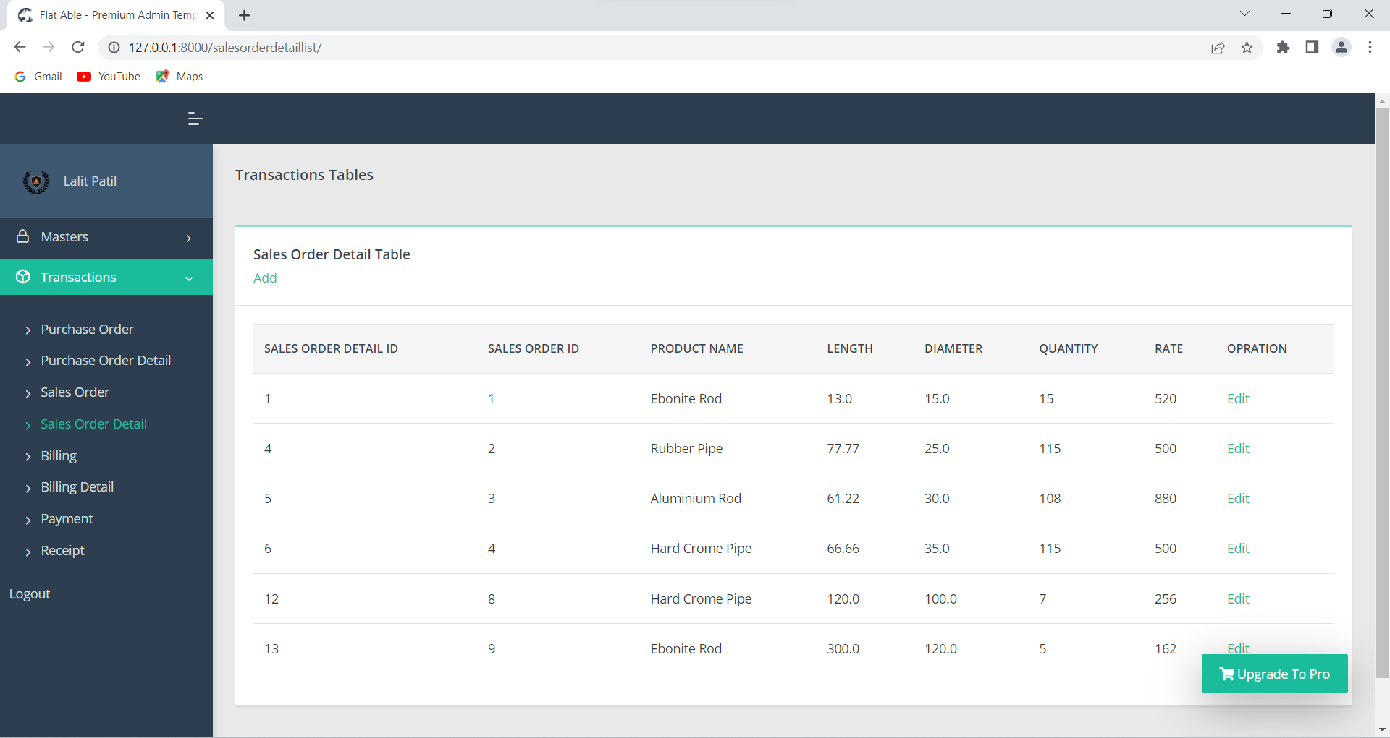
Sales order detail table:-

Slide 32
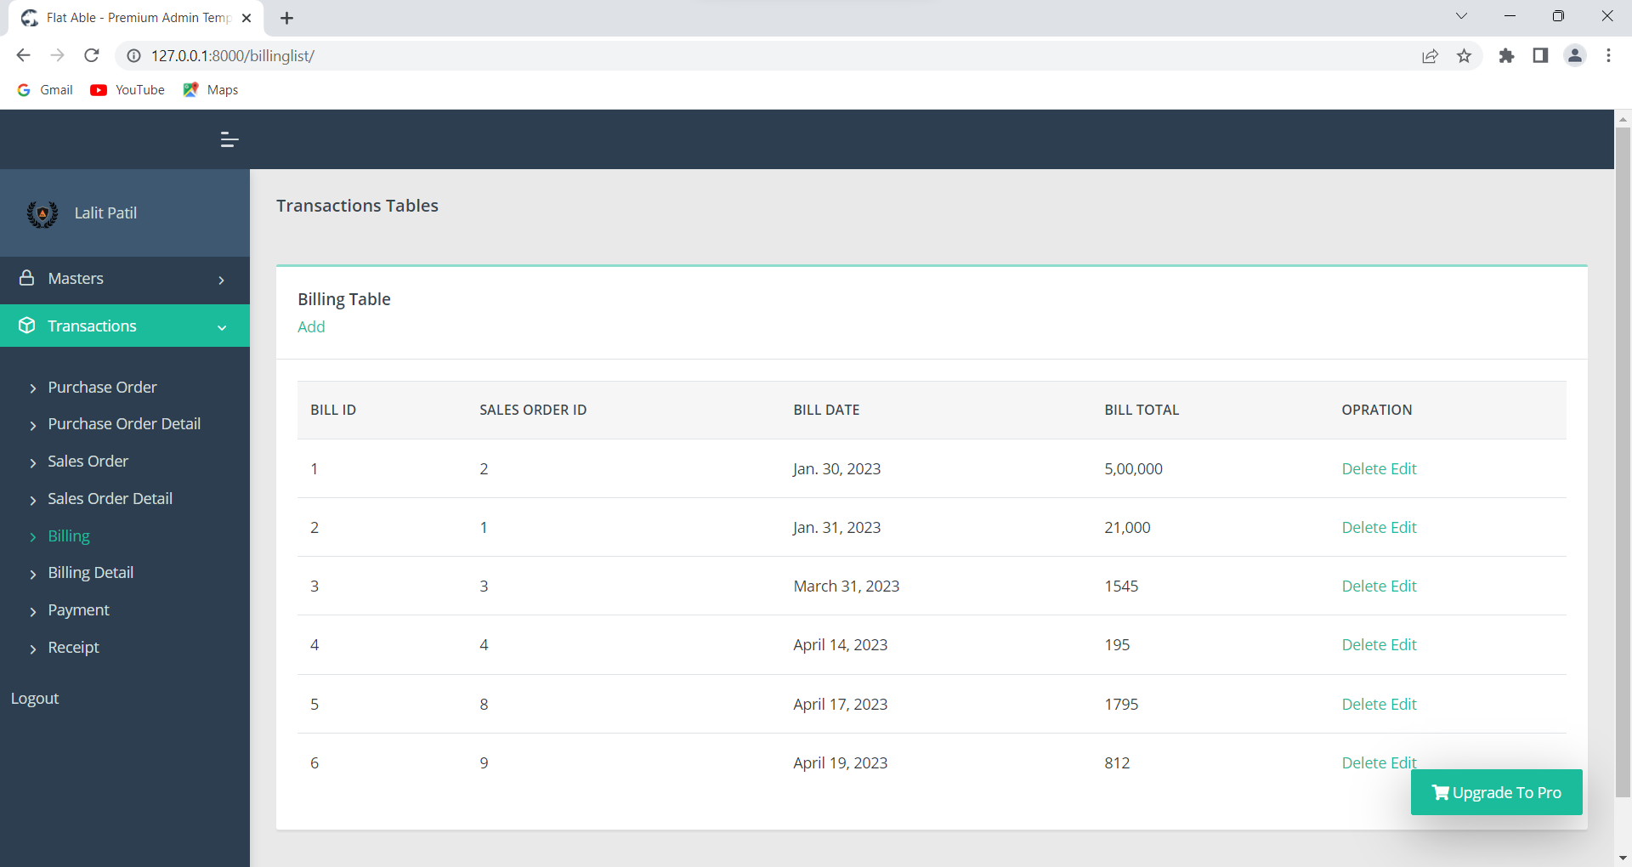
Billing Table:-

Slide 33
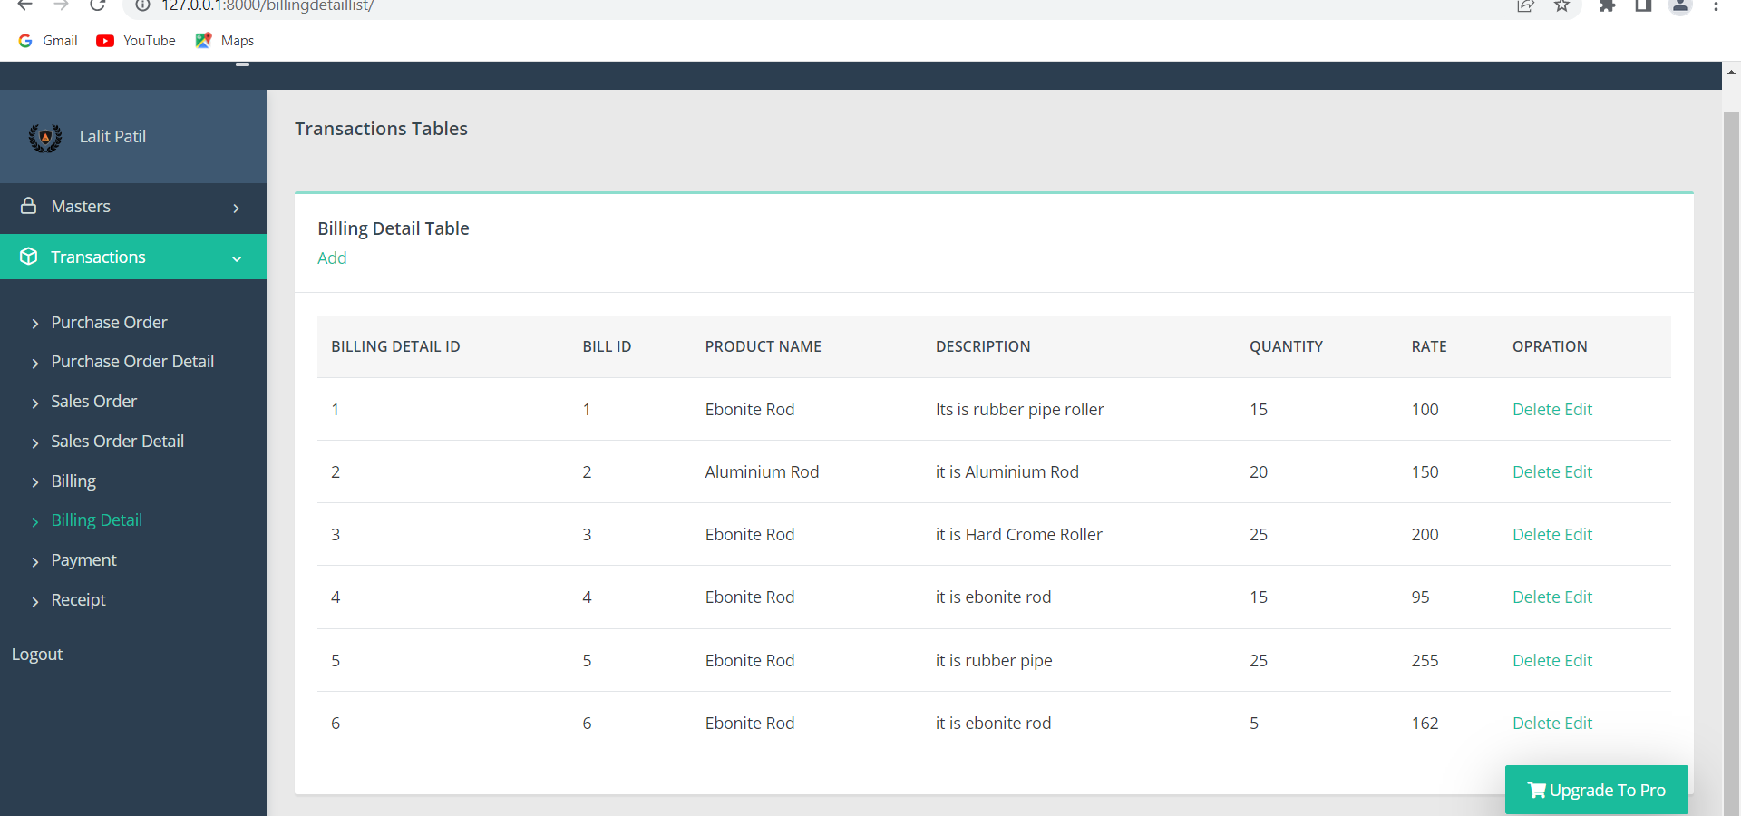
Billing detail table:-

Slide 34
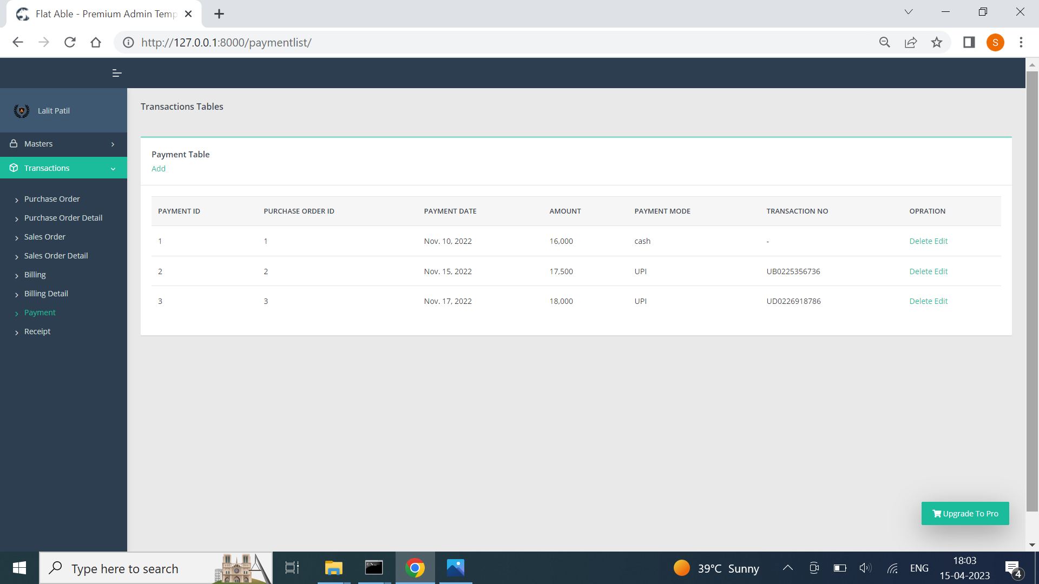
Payment table:-

Slide 35
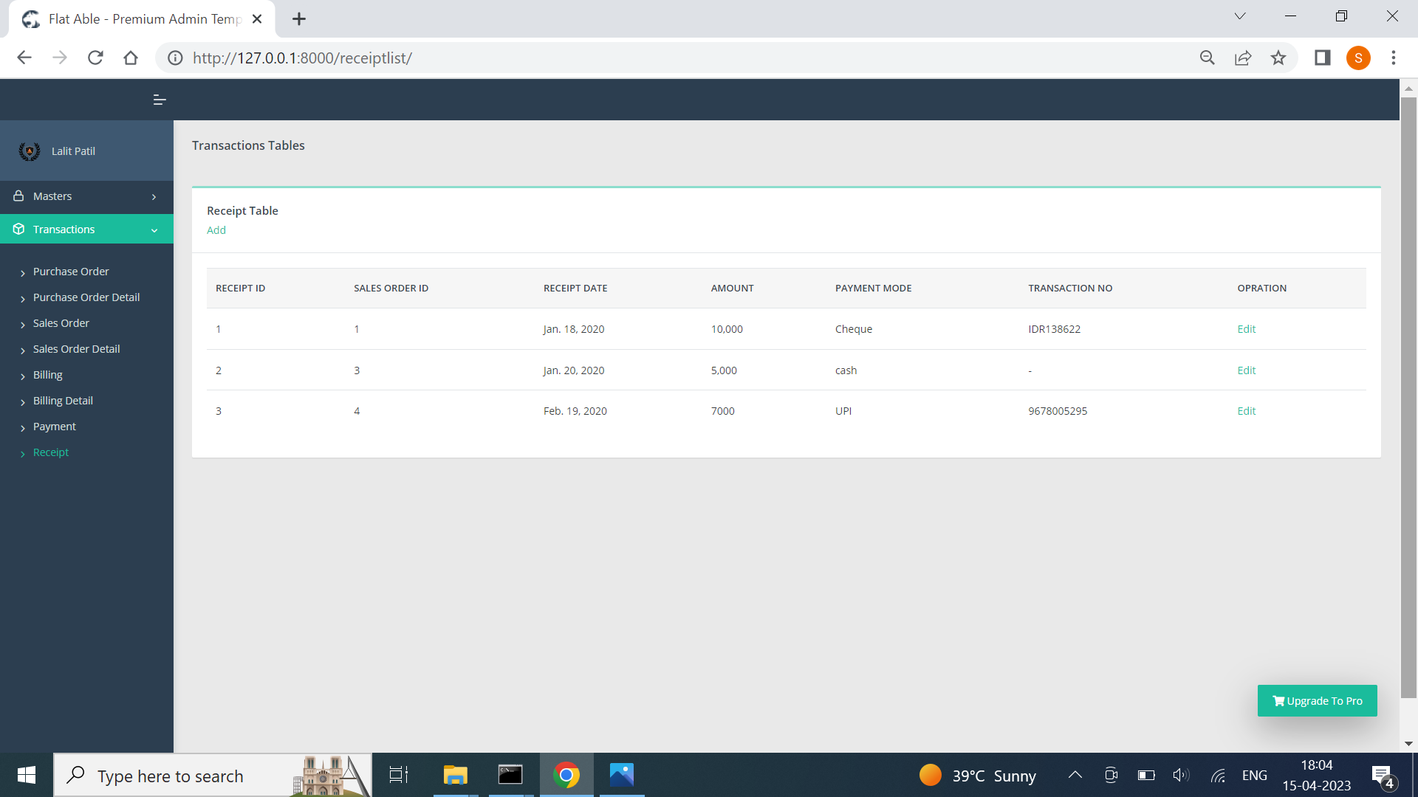
Receipt table:-

Slide 36


Slide 37
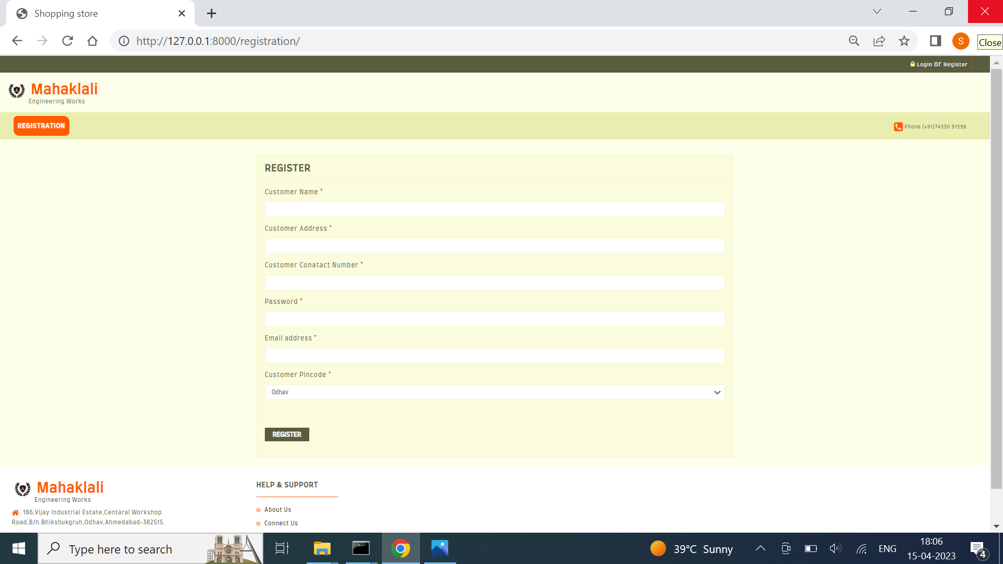
Registration:-

Slide 38


Slide 39
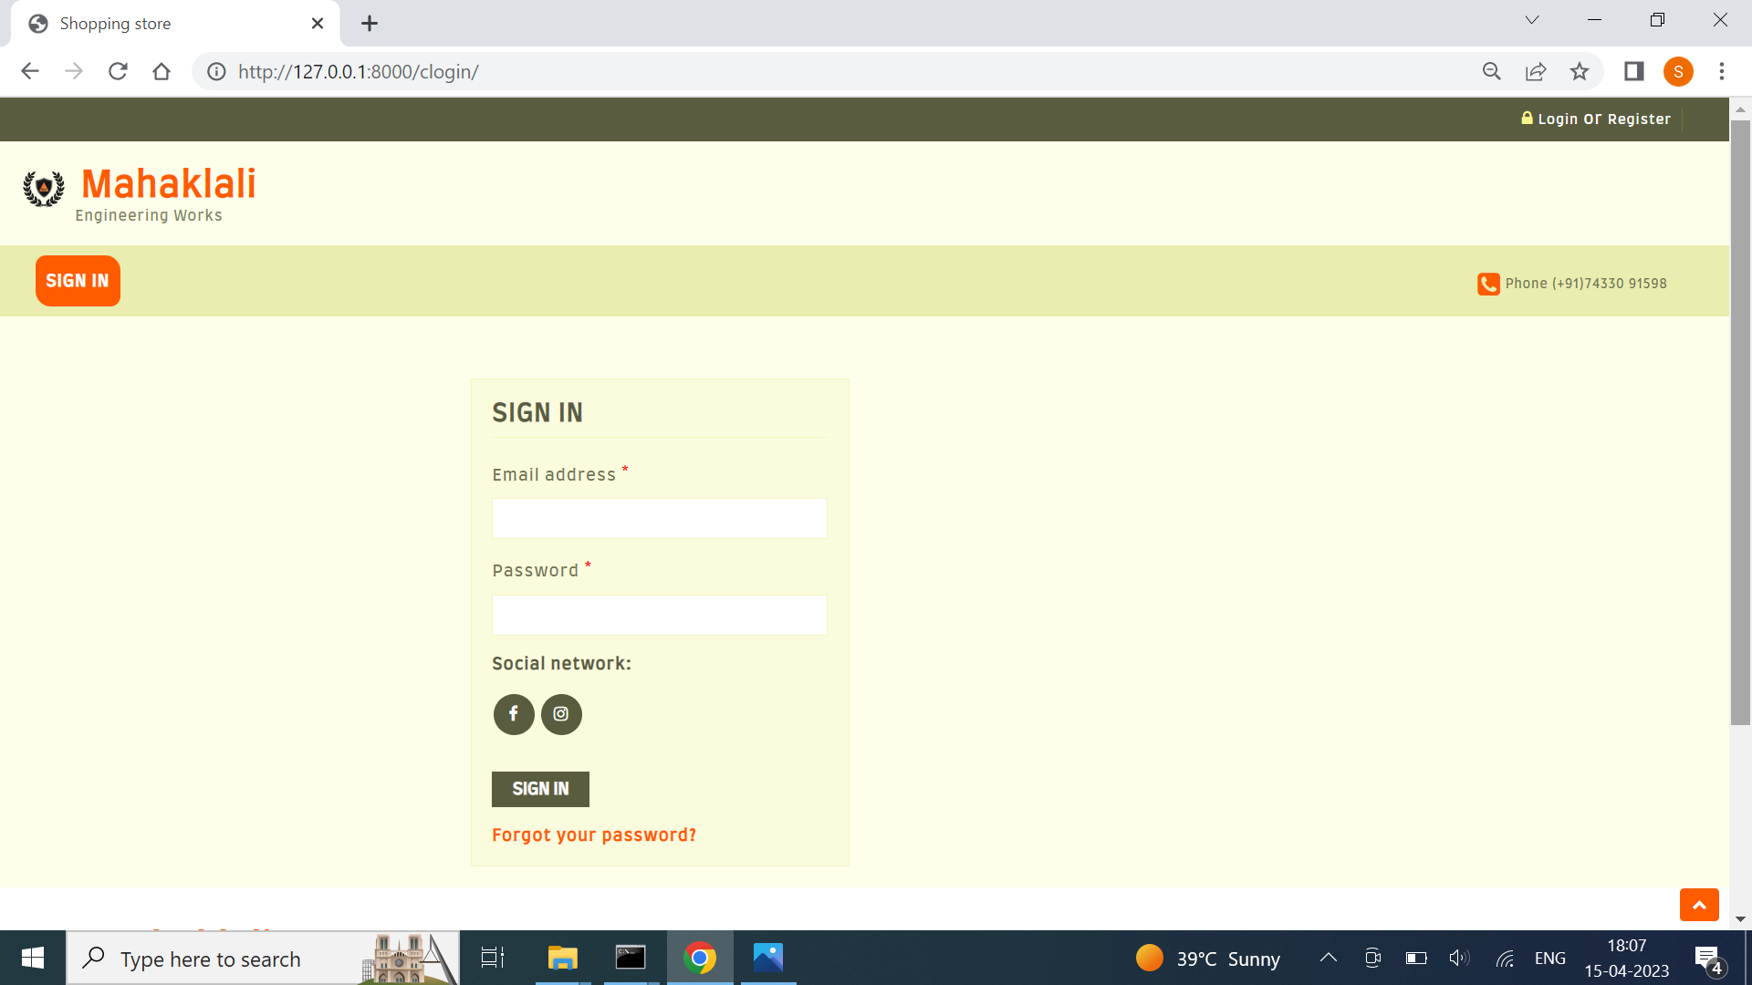
Sign in:-

Slide 40
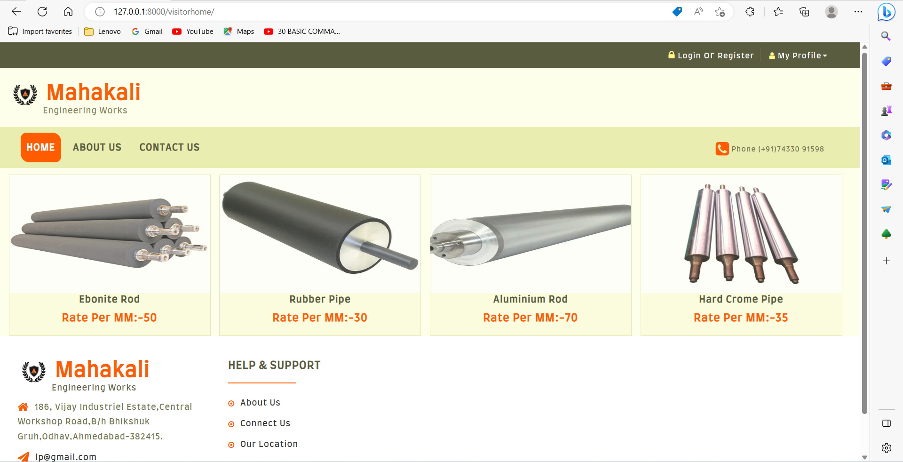

Slide 41
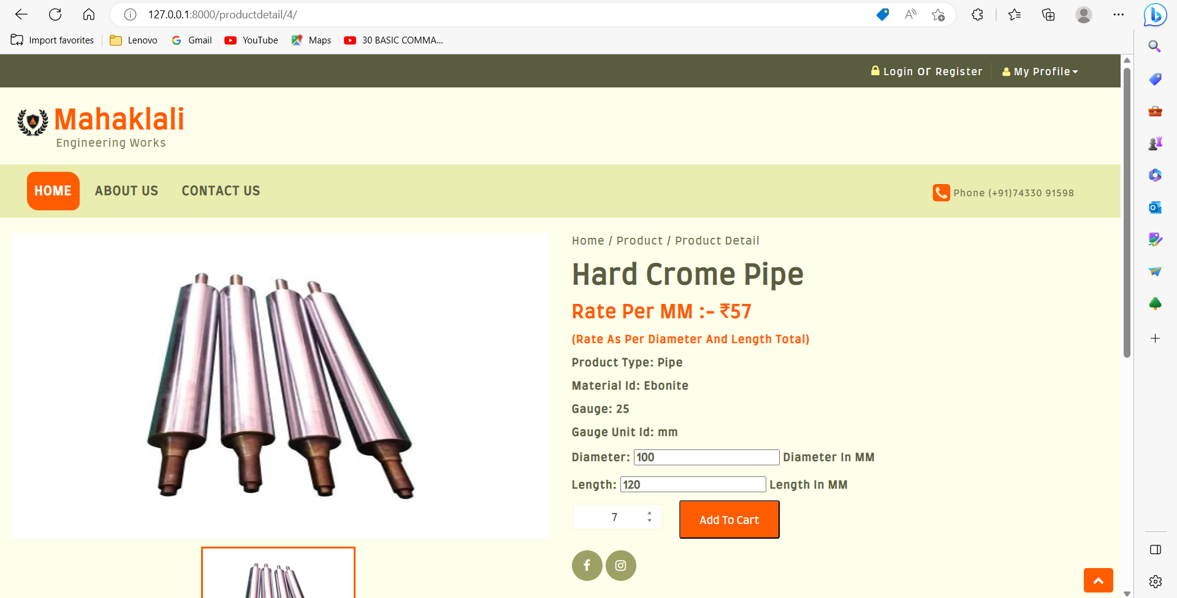

Slide 42
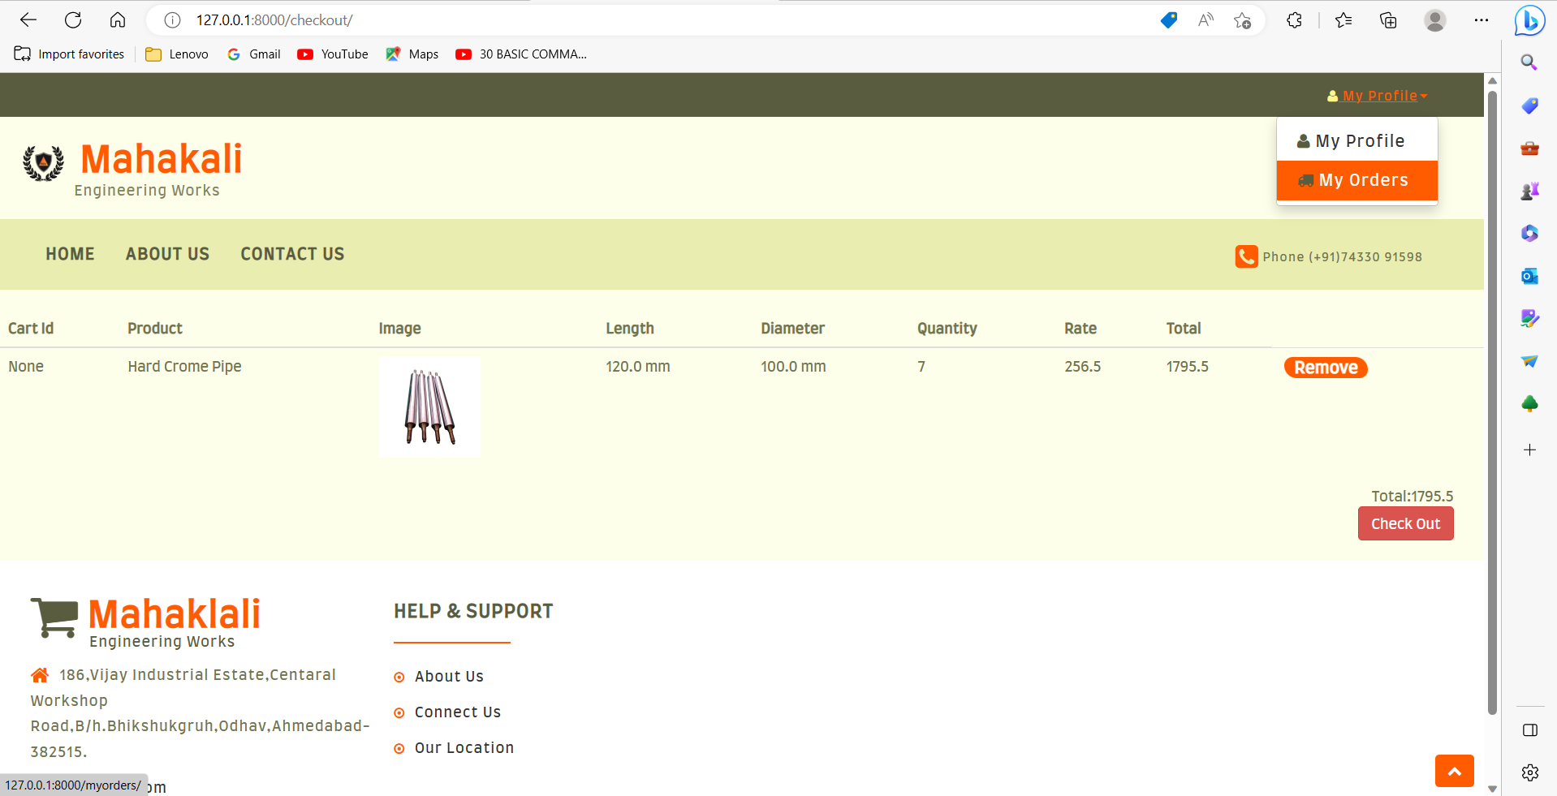
Add to cart:-

Slide 43
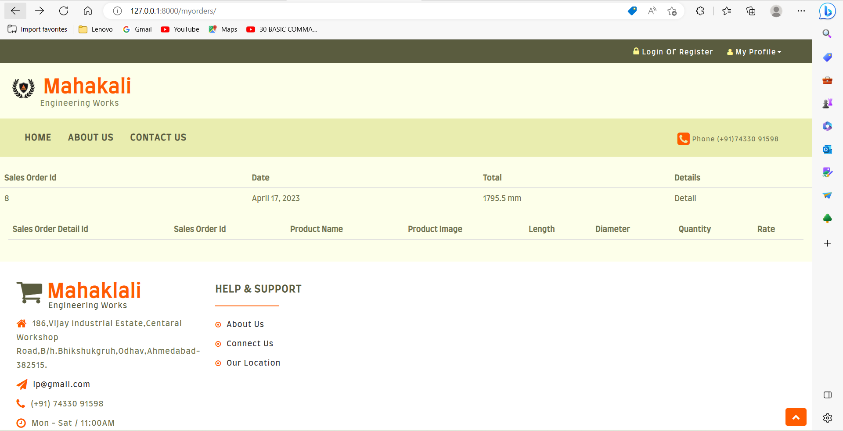
Order:-

Slide 44
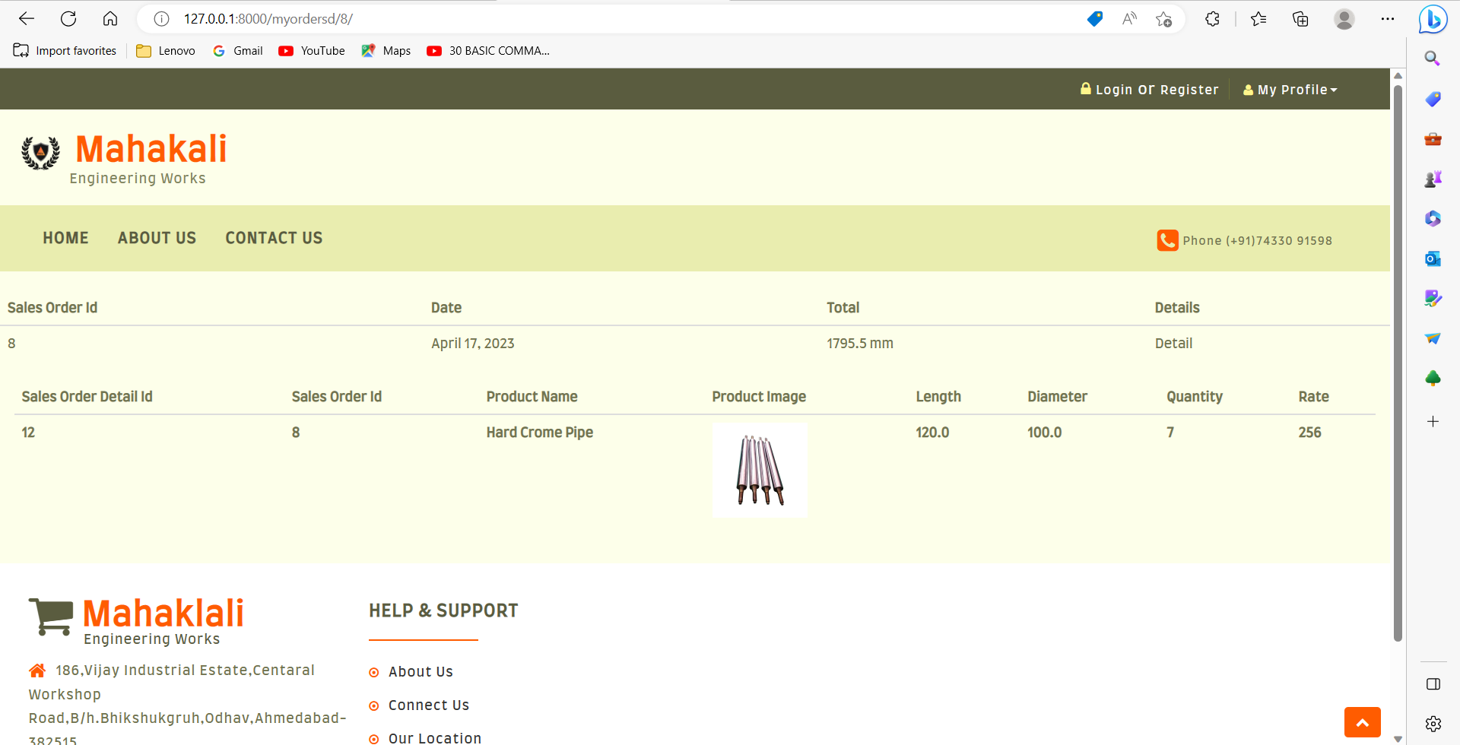

Slide 45
REPORT LAYOUT

Slide 46
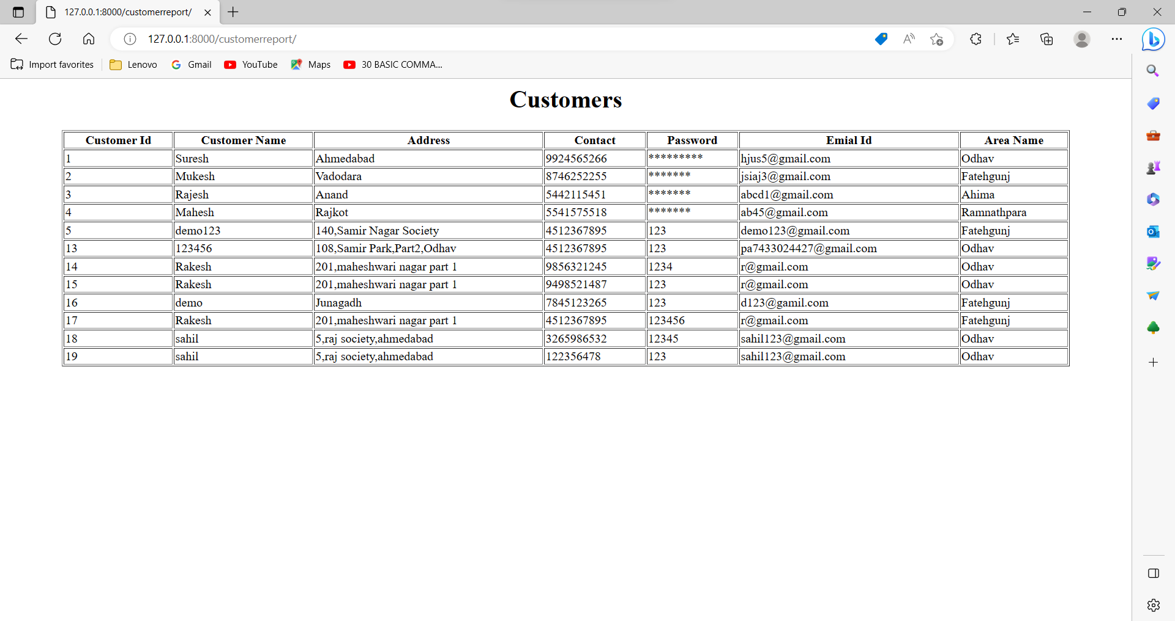

Slide 47
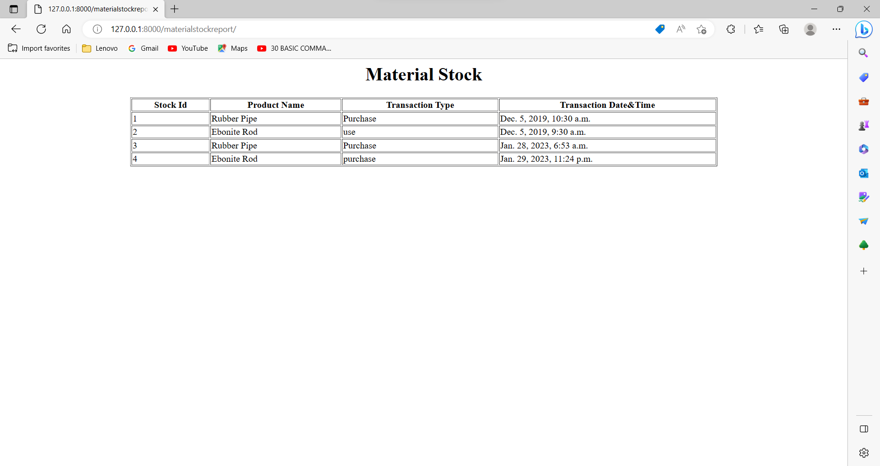

Slide 48
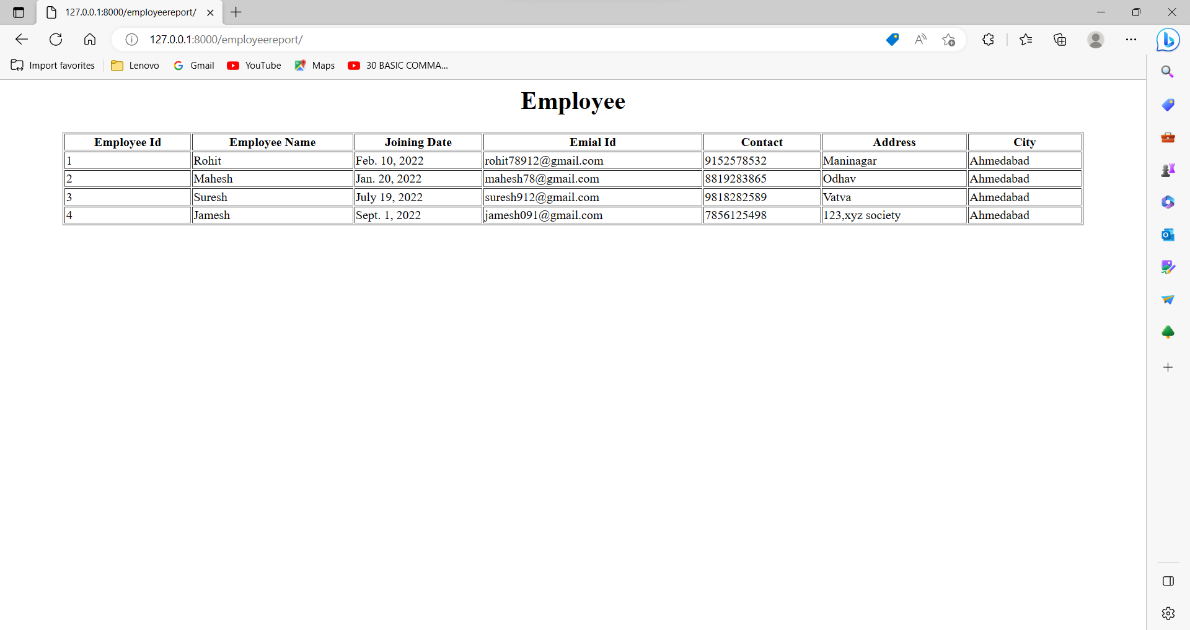

Slide 49
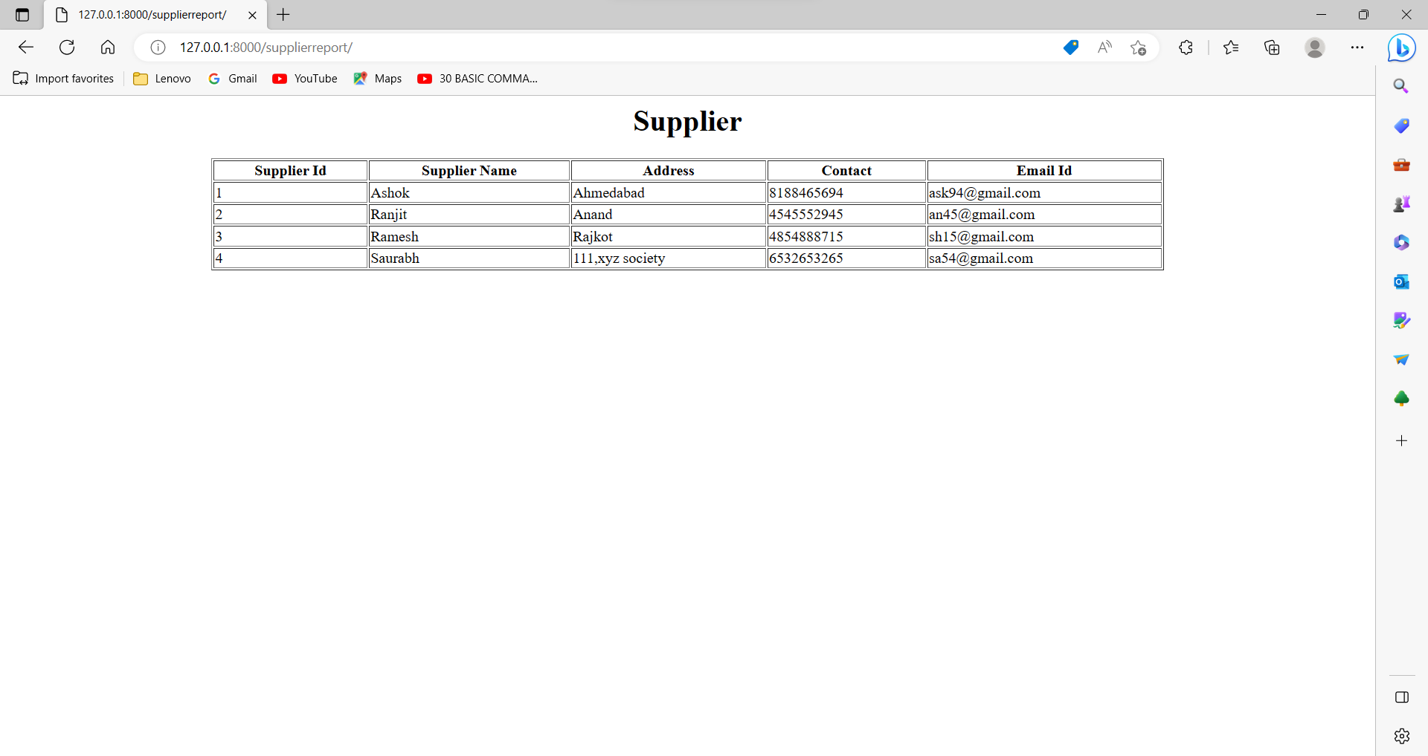

Slide 50
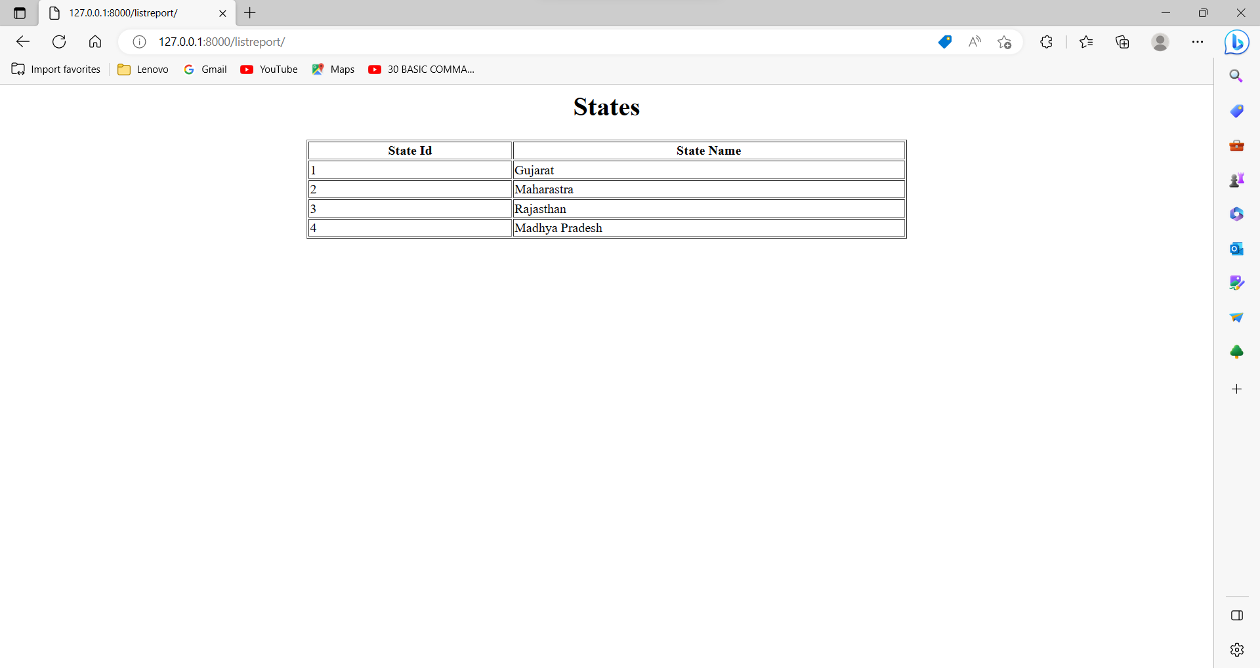

Slide 51
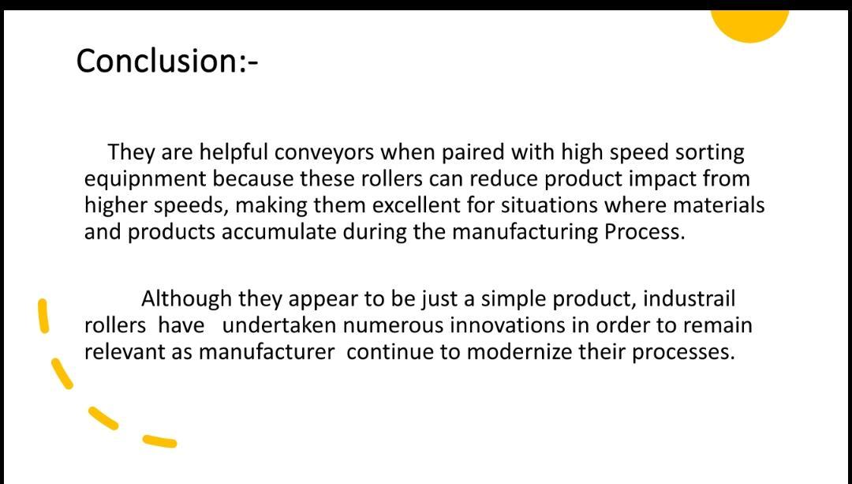

Slide 52
